Slide 1
What’s new in .NET world?
Miroslav Popović Technical Lead @Seavus @miroslavpopovic

Slide 3


Slide 4



Languages

Slide 5
C# 10
Open Source C# standardization
https://github.com/dotnet/csharpstandard
Global usings [Demo]
File-scoped namespaces [Demo]
Struct improvements [Demo]
Parameterless struct constructors
Record structs
with expression for all structs and anonymous types
Extended property pattern [Demo]
{ Prop1.Prop2: pattern } instead of { Prop1: { Prop2: pattern } }
Static abstracts in interfaces – in preview
In .NET 7, IParsable<T> and INumber<T> are examples
Improvements for lambda expressions and method groups
Inferring types
Attributes on lambdas – used in Minimal APIs
Improved compiled output for string interpolation and constant interpolated strings
Notes:
https://devblogs.microsoft.com/dotnet/announcing-open-source-c-standardization-standards/
https://devblogs.microsoft.com/dotnet/string-interpolation-in-c-10-and-net-6/
https://devblogs.microsoft.com/dotnet/preview-features-in-net-6-generic-math/#static-abstracts-in-interfaces
https://devblogs.microsoft.com/dotnet/announcing-net-6-release-candidate-2/#c-10
https://devblogs.microsoft.com/dotnet/welcome-to-csharp-10/

Slide 6
C# 11
Raw string literals [Demo]
No character escaping
At least three double quotes “””...”””
Can be interpolated by using $ prefixes
$, $$, $$$
number of $s defines the number of curly braces in content
New lines inside the “holes” of interpolated strings [Demo]
List patterns to match against lists and arrays [Demo]
Auto-default structs [Demo]
Required members (public require string Name { get; init; }) [Demo]
Generic attributes [Demo]
File-scoped types [Demo]
Pattern matching strings with spans
UTF-8 string literals – “CSharp”u8
Notes:
https://devblogs.microsoft.com/dotnet/early-peek-at-csharp-11-features/
https://devblogs.microsoft.com/dotnet/csharp-11-preview-august-update/
https://thecodeblogger.com/2022/09/18/c-11-introducing-support-for-generic-attributes/
https://www.roundthecode.com/dotnet/c-sharp-11-preview-features-dotnet-7
https://github.com/dotnet/csharplang
https://devclass.com/2022/08/22/c-11-coming-soon-generic-math-required-class-members-raw-string-literals/
https://learn.microsoft.com/en-us/dotnet/csharp/whats-new/csharp-11

Slide 7
F# 6
Task based async
task {...} in addition to async {...}
Faster and more interoperable with .NET
expr[idx] instead of expr.[idx]
Indentation syntax is more uniform
Improved performance and debugging for list and array expressions
Implicit conversions between some types
Pipeline debugging
Improvements to compiler/IDE-tooling both in terms of performance and scalability
Notes:
https://devblogs.microsoft.com/dotnet/whats-new-in-fsharp-6/
https://devblogs.microsoft.com/dotnet/fsharp-6-is-officially-here/

Slide 8
Visual Basic
No new features, other than shared .NET ones
Some improvements in Visual Studio 2022, like refactorings

Slide 9

BCL and tools

Slide 10
New library APIs in .NET 6
Micorosoft.Extensions.Logging compile-time source generator [Demo]
System.Linq [Demo]
Enumerable support for Index and Range parameters
DistinctBy, UnionBy, IntersectBy, ExceptBy
MaxBy, MinBy
Chunk
System.Collections.Generics.PriorityQueue<TElement, TPriority> [Demo]
DateOnly, TimeOnly structs [Demo]
Low level API for reading and writing files – File.OpenHandle(“file.name”) [Demo]
New Math API
SinCos, ReciprocalEstimate, ReciprocalSqrtEstimate
Parallel.ForEachAsync
More analyzers are added to Roslyn
Notes:
https://devblogs.microsoft.com/dotnet/announcing-net-6-preview-4/#system-linq-enhancements
https://devblogs.microsoft.com/dotnet/announcing-net-6-preview-4/#enhanced-date-time-and-time-zone-support
https://devblogs.microsoft.com/dotnet/date-time-and-time-zone-enhancements-in-net-6/
https://devblogs.microsoft.com/dotnet/announcing-net-6-preview-7/#early-net-7-feature-preview-generic-math
https://devblogs.microsoft.com/dotnet/new-dotnet-6-apis-driven-by-the-developer-community/
https://devblogs.microsoft.com/dotnet/dotnet-6-networking-improvements/

Slide 11
System.Text.Json in .NET 6
Source generator for System.Text.Json [Demo]
More overloads for JsonSerializer [Demo]
Extensions for HttpClient and JsonContent [Demo]
Notification for (de)serialization [Demo]
IJsonOnDeserialized, IJsonOnDeserializing, IJsonOnSerialized, IJsonOnSerializing
[JsonPropertyOrder(x)] for serialization [Demo]
Writable DOM
ReferenceHandler.IgnoreCycles – for reference loop handling
Write raw JSON using Utf8JsonWriter
Notes:
https://devblogs.microsoft.com/dotnet/announcing-net-6-preview-4/#system-text-json-writable-dom-feature
https://devblogs.microsoft.com/dotnet/announcing-net-6-preview-5/#libraries-jsonserializer-source-generation
https://devblogs.microsoft.com/dotnet/try-the-new-system-text-json-source-generator/
https://devblogs.microsoft.com/dotnet/announcing-net-6-preview-7/#libraries-system-text-json-serialization-notifications
https://devblogs.microsoft.com/dotnet/announcing-net-6-preview-7/#libraries-write-raw-json-with-system-text-json-utf8jsonwriter
https://devblogs.microsoft.com/dotnet/performance-improvements-in-net-6/#json

Slide 12
New library APIs in .NET 7
Generic math [Demo]
System.Numerics
INumber<T>, IBinaryInteger, IFloatingPoint, INumberBase, ISignedNumber
Separate interfaces for functions and operators – like IAdditionOperators
C# feature - using static abstract methods in interfaces
New Regex APIs
RegexGenerator and Roslyn analyzers [Demo]
RegexOptions.NonBacktracking
A lot of other improvements
Rate limiting – System.Threading.RateLimiting
Concurrency, token bucket, fixed window, sliding window, partitioned...
Microseconds and Nanoseconds in date and time types [Demo]
New Stream methods – ReadExactly[Async] and ReadAtLeast[Async]
Tar archive support – System.Formats.Tar assembly
Support for Unix file modes
Template authoring improvements
Constraints (OS, workload, host), multi-choice parameters, better exit codes and error reporting
Notes:
https://devblogs.microsoft.com/dotnet/announcing-dotnet-7-preview-4/#adding-microseconds-and-nanoseconds-to-timestamp-datetime-datetimeoffset-and-timeonly
https://devblogs.microsoft.com/dotnet/regular-expression-improvements-in-dotnet-7/
https://devblogs.microsoft.com/dotnet/dotnet-7-generic-math/
https://devblogs.microsoft.com/dotnet/announcing-dotnet-7-preview-5/
https://devblogs.microsoft.com/dotnet/announcing-dotnet-7-preview-6/#system-formats-tar-api-updates
https://devblogs.microsoft.com/dotnet/announcing-dotnet-7-preview-6/#template-authoring
https://devblogs.microsoft.com/dotnet/announcing-rate-limiting-for-dotnet/
https://devblogs.microsoft.com/dotnet/announcing-dotnet-7-preview-7/#support-for-unix-file-modes

Slide 13
System.Text.Json in .NET 7
Polymorphism [Demo]
JsonDerivedType
JSON contract customization [Demo]
Adding type modifiers to DefaultJsonTypeInfoResolver
Creating custom IJsonTypeInfoResolver
Conditional property serialization
Source generation support for IAsyncEnumerable, JsonDocument and DateOnly/TimeOnly types
C# 11 required members support – throws exception
Utf8JsonReader.CopyString()
Notes:
https://devblogs.microsoft.com/dotnet/announcing-dotnet-7-preview-5/#system-text-json
https://devblogs.microsoft.com/dotnet/announcing-dotnet-7-preview-6/
https://devblogs.microsoft.com/dotnet/performance_improvements_in_net_7/#json

Slide 14
Targeting
<TargetFramework>.net6.0</TargetFramework>
<TargetFramework> .net6.0-android,.net6.0-ios,.net6.0-windows </TargetFramework>

Slide 15
.NET 6 SDK
Workloads
Single-file apps improvements
Work on Windows and macOS too, in addition to Linux
Static analysis
Compression
More aggressive IL trimming
Reduced app size
Arm64 on Windows and macOS
Modernized templates [Demo]
Top-level statements
async Main
Global using directives
File-scoped namespaces
Target-type new expressions
Nullable reference types
Notes:
https://devblogs.microsoft.com/dotnet/announcing-net-6-preview-7/#net-sdk-c-project-templates-modernized
https://devblogs.microsoft.com/dotnet/announcing-net-6-release-candidate-2/#macos-and-windows-arm64-update
https://devblogs.microsoft.com/dotnet/announcing-net-6/

Slide 16
.NET 7 SDK
Native AOT
No longer experimental
Generates code at build time instead of runtime
Improves startup time, memory usage, access to restricted platforms (no JIT), size on disk
Console apps and native libraries
New CLI parser
“dotnet new” improved CLI
“dotnet --info” updates
Central Package Management – Directory.Packages.props
Improved .NET host error messages – i.e., missing runtime errors
Console.ReadKey improved, especially for Linux
Notes:
https://devblogs.microsoft.com/dotnet/announcing-dotnet-7-preview-2/
https://devblogs.microsoft.com/dotnet/announcing-dotnet-7-preview-3/
https://devblogs.microsoft.com/dotnet/announcing-dotnet-7-preview-4/
https://devblogs.microsoft.com/dotnet/dotnet-apphost-improvements/
https://devblogs.microsoft.com/dotnet/console-readkey-improvements-in-net-7/
https://learn.microsoft.com/en-gb/dotnet/core/deploying/native-aot/

Slide 17
Tools .NET 6
Hot Reload
Nearly a fiasco, that would work in VS 2022 only
Decision reverted after 3 days
Available through dotnet watch and VS2022
.NET Upgrade Assistant
https://github.com/dotnet/upgrade-assistant
New Crossgen (Crossgen2)
ReadyToRun format – ahead of time compilation
.NET 6 is included in Ubuntu 22.04
apt install dotnet6
Notes:
Crossgen2 – cross-compilation across operating systems and architectures – single build machine to generate native code for all targets
https://devblogs.microsoft.com/dotnet/conversation-about-crossgen2/
https://devblogs.microsoft.com/dotnet/announcing-net-6-preview-4/#built-in-sdk-version-checking
https://devblogs.microsoft.com/dotnet/update-on-net-hot-reload-progress-and-visual-studio-2022-highlights/
https://devblogs.microsoft.com/dotnet/net-hot-reload-support-via-cli/
https://devblogs.microsoft.com/dotnet/dotnet-6-is-now-in-ubuntu-2204/

Slide 18
Tools .NET 7
Hot Reload improvements
for Blazor WebAssembly, iOS and Android
More lambda methods support
Adding new static fields, static methods, and non-virtual instance methods
Adding new classes
dotnet watch restarts for rude edits
Notes:
https://devblogs.microsoft.com/dotnet/announcing-net-7-preview-1/

Slide 19

Performance improvements

Slide 20
Performance improvements in .NET 6
Considerably reduced memory allocations
Improved performance on API-by-API basis
ThreadPool and Tasks
FileStream rewritten
System.Net.Sockets and System.Net.Dns
Reflection
Collections and LINQ
Cryptography
Improving inner-loop performance for .NET developers
Hot Reload, Hot Restart
Improved build times
Faster and smarter JIT inlining
New PGO and dynamic PGO – profile-guided optimization
Loop alignment / code alignment
Notes:
https://devblogs.microsoft.com/dotnet/loop-alignment-in-net-6/
https://devblogs.microsoft.com/dotnet/announcing-net-6-preview-3/
https://devblogs.microsoft.com/dotnet/performance-improvements-in-net-6/
https://devblogs.microsoft.com/dotnet/file-io-improvements-in-dotnet-6/
https://devblogs.microsoft.com/dotnet/announcing-net-6-release-candidate-1/#profile-guided-optimization-pgo
https://devblogs.microsoft.com/dotnet/announcing-net-6/#performance
https://devblogs.microsoft.com/dotnet/dotnet-6-networking-improvements/

Slide 21
Performance improvements in .NET 7
Improvements in existing CodeGen / JIT features
Dynamic PGO
Arm64
Loop optimizations
Logging source generator improvements
On-Stack Replacement (OSR)
Mono performance improved
Regex source generator and other regex performance improvements
Reflection and Interop
Threading improvement
Primitive types parsing, formatting and equality
Arrays, strings, Collections and Spans
LINQ Min, Max, Sum, Average
JSON, XML, Compression, Cryptography, Diagnostics, Exceptions...
Notes:
https://devblogs.microsoft.com/dotnet/performance_improvements_in_net_7/
https://devblogs.microsoft.com/dotnet/arm64-performance-improvements-in-dotnet-7/

Slide 22

Entity Framework Core

Slide 23
New in EF Core 6
Performance improvements
EF Core 6.0 is 40-70% faster than 5.0
Memory allocations decreased considerably
Performance closed to Dapper in almost all situations
DevOps friendly migration bundles – self-contained executable
dotnet ef migrations bundle
Mapping attributes
Unicode, Precision, EntityTypeConfiguration
Reduced startup time via compiled models
Pre-convention model configuration
Improved Cosmos DB support
SQL Server temporal tables support
Notes:
https://devblogs.microsoft.com/dotnet/announcing-entity-framework-core-6-0-preview-4-performance-edition/
https://devblogs.microsoft.com/dotnet/announcing-entity-framework-core-6-0-preview-5-compiled-models/
https://devblogs.microsoft.com/dotnet/announcing-entity-framework-core-6-0-preview-6-configure-conventions/
https://devblogs.microsoft.com/dotnet/taking-the-ef-core-azure-cosmos-db-provider-for-a-test-drive/
https://devblogs.microsoft.com/dotnet/prime-your-flux-capacitor-sql-server-temporal-tables-in-ef-core-6-0/#sql-server-temporal-tables

Slide 24
New in EF Core 7
JSON columns in relational databases
Bulk updates
Performance improvements on inserts and updates (SaveChanges)
Map CUD operations to stored procedures
Table-per-concrete-type (TPC) mapping
Override model building conventions
Database scaffolding T4 templates
Interceptors improvements
Intercept, modify, and/or suppress EF core operation
Query enhancements
...
Notes:
https://devblogs.microsoft.com/dotnet/announcing-the-plan-for-ef7/
https://devblogs.microsoft.com/dotnet/announcing-entity-framework-7-preview-3/
https://devblogs.microsoft.com/dotnet/announcing-ef7-preview5/
https://devblogs.microsoft.com/dotnet/announcing-ef-core-7-preview6-performance-optimizations/
https://devblogs.microsoft.com/dotnet/announcing-ef7-preview7-entity-framework/
https://devblogs.microsoft.com/dotnet/announcing-ef7-release-candidate-2/
https://learn.microsoft.com/en-gb/ef/core/what-is-new/ef-core-7.0/whatsnew

Slide 25

ASP.NET Core

Slide 26
ASP.NET Core 6 features
Hot Reload
HTTP/3 and QUIC
Kestrel is default launch profile
Source generators in Razor compiler – improved build times
CSS isolation for MVC Views and Razor Pages
JavaScript modules
Single-file publishing
Async streaming using IAsyncEnumerable
Updated templates
SPA support upgraded
Duende IdentityServer upgraded
Bootstrap upgraded
Smaller JS scripts for SignalR, Blazor Server and MessagePack
HTTP logging and W3CLogger middleware
Shadow-copying in IIS [Preview]
Notes:
https://devblogs.microsoft.com/dotnet/asp-net-core-updates-in-net-6-preview-3/
https://devblogs.microsoft.com/dotnet/asp-net-core-updates-in-net-6-preview-4/#async-streaming
https://devblogs.microsoft.com/dotnet/asp-net-core-updates-in-net-6-preview-4/#http-logging-middleware
https://devblogs.microsoft.com/dotnet/asp-net-core-updates-in-net-6-preview-4/#use-kestrel-for-the-default-launch-profile-in-new-projects
https://devblogs.microsoft.com/dotnet/asp-net-core-updates-in-net-6-preview-4/#improved-single-page-app-spa-templates
https://devblogs.microsoft.com/dotnet/asp-net-core-updates-in-net-6-preview-4/#net-hot-reload-updates
https://devblogs.microsoft.com/dotnet/asp-net-core-updates-in-net-6-preview-7/#add-w3clogger
https://devblogs.microsoft.com/dotnet/http-3-support-in-dotnet-6/
https://devblogs.microsoft.com/dotnet/announcing-asp-net-core-in-net-6/#whats-new
https://devblogs.microsoft.com/dotnet/performance-improvements-in-aspnet-core-6/

Slide 27
Minimal APIs in ASP.NET Core 6
New hosting APIs [Demo]
WebApplication and WebApplicationBuilder
New routing APIs [Demo]
MapGet, MapPost, MapPut, MapDelete, MapMethods
app.MapGet("/", () => "This is a GET");
Increased performance
Beginner friendly - lower barrier of entry
OpenAPI support [Demo]
Improved integration testing [Demo]
WebApplicationFactory instead of TestServer
Notes:
https://devblogs.microsoft.com/dotnet/asp-net-core-updates-in-net-6-preview-4/#introducing-minimal-apis
https://devblogs.microsoft.com/dotnet/asp-net-core-updates-in-net-6-preview-6/#openapi-support-in-minimal-apis
https://gist.github.com/davidfowl/0e0372c3c1d895c3ce195ba983b1e03d

Slide 28
ASP.NET Core 7 features
RateLimiting middleware
Output caching middleware
Incremental ASP.NET migration tooling
Kestrel improvements
Support for WebSockets over HTTP/2
Performance improved on high core machines
HTTP/2 performance improvement - gRPC, file uploads
HTTP/3 – performance improvement, WebTransport support [Experimental]
New problem details service
Request decompression middleware (Brotli, Deflate, and GZip)
No longer required to use [FromServices] in action method parameters
TryParse method support for action method parameters
Dark mode for developer exception page
Notes:
https://devblogs.microsoft.com/dotnet/asp-net-core-updates-in-dotnet-7-preview-2/
https://devblogs.microsoft.com/dotnet/asp-net-core-updates-in-dotnet-7-preview-4/#http-2-performance-improvements
https://devblogs.microsoft.com/dotnet/asp-net-core-updates-in-dotnet-7-preview-5/#jwt-authentication-improvements-automatic-authentication-configuration – this has been partially removed from .NET 7
https://devblogs.microsoft.com/dotnet/incremental-asp-net-migration-tooling-preview-2/
https://devblogs.microsoft.com/dotnet/asp-net-core-updates-in-dotnet-7-preview-6/
https://devblogs.microsoft.com/dotnet/announcing-rate-limiting-for-dotnet/#ratelimiting-middleware
https://devblogs.microsoft.com/dotnet/asp-net-core-updates-in-dotnet-7-rc-1/
https://devblogs.microsoft.com/dotnet/experimental-webtransport-over-http-3-support-in-kestrel/
https://devblogs.microsoft.com/dotnet/migrating-from-asp-net-to-asp-net-core-part-4/
https://blog.maartenballiauw.be/post/2022/09/26/aspnet-core-rate-limiting-middleware.html
https://devblogs.microsoft.com/dotnet/asp-net-core-updates-in-dotnet-7-rc-2/
https://blog.maartenballiauw.be/post/2022/10/03/rate-limiting-web-applications-concepts-approaches.html
https://ignite.microsoft.com/en-US/sessions/639d9c8d-e826-4a51-9e75-4c2c402b410a

Slide 29
Minimal APIs in ASP.NET Core 7
IEndpointFilter support [Demo]
IFormFile and IFormFileCollection
Binding to Stream or PipeReader
Binding a set of parameters into a single object with props using [AsParameters]
Endpoint description and summaries used for OpenAPI [Demo]
Binding arrays
IResult implementations are now public and have new interfaces [Demo]
IContentTypeHttpResult, IFileHttpResult, INestedHttpResult, IStatusCodeHttpResult, IValueHttpResult
Typed results – Microsoft.AspNetCore.Http.TypedResults
Self-describing minimal APIs
IEndpointMetadataProvider, IEndpointParameterMetadataProvider
Uses C# 11 static abstract interface members, works with TypedResults
Route groups with MapGroup()
Notes:
https://devblogs.microsoft.com/dotnet/asp-net-core-updates-in-net-7-preview-1/
https://devblogs.microsoft.com/dotnet/asp-net-core-updates-in-dotnet-7-preview-2/
https://devblogs.microsoft.com/dotnet/asp-net-core-updates-in-dotnet-7-preview-3/
https://devblogs.microsoft.com/dotnet/asp-net-core-updates-in-dotnet-7-preview-4/
https://devblogs.microsoft.com/dotnet/asp-net-core-updates-in-dotnet-7-preview-5/
https://devblogs.microsoft.com/dotnet/asp-net-core-updates-in-dotnet-7-preview-7/

Slide 30
SignalR in .NET 6
SignalR Client package annotated for nullability
WebSocket compression – disabled by default
CloseOnAuthenticationExpiration option
Close the connection if the authentication token expires
Testing improvements
WebSocketFactory is in options when creating .NET SignalR connection – can be used with Test server
Notes:
https://devblogs.microsoft.com/dotnet/asp-net-core-updates-in-net-6-preview-6/#websocket-compression
Enabling compression over encrypted connection can make the app subject to CRIME/BREACH attacks
https://devblogs.microsoft.com/dotnet/asp-net-core-updates-in-net-6-preview-6/#signalr-websockets-testserver-support

Slide 31
SignalR in .NET 7
Client source generator
Dependency injection for hub methods
Invoke client results from server using Clients.Single(connId).InvokeAsync<T>()
Notes:
https://devblogs.microsoft.com/dotnet/asp-net-core-updates-in-net-7-preview-1/#signalr-client-source-generator
https://devblogs.microsoft.com/dotnet/asp-net-core-updates-in-dotnet-7-preview-2/

Slide 32

Blazor

Slide 33
New features in .NET 6
Rendering Blazor components from JavaScript
Custom elements – HTML standard interface [experimental]
Blazor WebAssembly AOT compilation
Reduced Blazor WebAssembly download size with runtime relinking
Streaming interop from JavaScript to .NET
much faster file uploads and large file support
Preserve server-side prerendered states
Custom event arguments
ErrorBoundary component [Demo]
Accepting component parameters from query string – [SupplyParameterFromQuery] [Demo]
Improved accessibility in templates [Demo]
new FocusOnNavigate component
Modify <head> content from Blazor components [Demo]
using PageTitle and HeadContent components, and HeadOutlet for destination
Support for multiple attribute on <select> element [Demo]
Custom deployment for Blazor to avoid issue with downloading dlls in some environments
Linking native WebAssembly dependencies
Notes:
https://devblogs.microsoft.com/dotnet/asp-net-core-updates-in-net-6-preview-4/#blazor-webassembly-ahead-of-time-aot-compilation
https://devblogs.microsoft.com/dotnet/asp-net-core-updates-in-net-6-preview-5/#reduced-blazor-webassembly-download-size-with-runtime-relinking
https://devblogs.microsoft.com/dotnet/asp-net-core-updates-in-net-6-preview-7/#supply-blazor-component-parameters-from-the-query-string
https://devblogs.microsoft.com/dotnet/asp-net-core-updates-in-net-6-rc-1/#render-blazor-components-from-javascript
https://devblogs.microsoft.com/dotnet/custom-deployment-layout-for-blazor-webassembly-apps/

Slide 34
New features in .NET 7
Support for System.Security.Cryptography
Blazor custom elements are no longer experimental
QuickGrid component [experimental]
https://aspnet.github.io/quickgridsamples/
New loading page [Demo]
Interoperability between .NET 7 and JavaScript through .NET WebAssembly runtime
WebAssembly multithreading [experimental]
Empty Blazor project templates
@bind:get (value), @bind:set (callback), @bind:after (async) modifiers
NavigationManager – pass state
Dynamic authentication requests in Blazor WebAssembly – custom params
Improved diagnostics for authentication in Blazor WebAssembly
Blazor WebAssembly debugging improvements
Notes:
https://devblogs.microsoft.com/dotnet/asp-net-core-updates-in-dotnet-7-preview-6/
https://devblogs.microsoft.com/dotnet/asp-net-core-updates-in-dotnet-7-preview-7/
https://devblogs.microsoft.com/dotnet/use-net-7-from-any-javascript-app-in-net-7/
https://devblogs.microsoft.com/dotnet/asp-net-core-updates-in-dotnet-7-rc-2/
https://www.infoq.com/news/2022/10/javascript-interop-dotnet-7-rc-1/

Slide 35
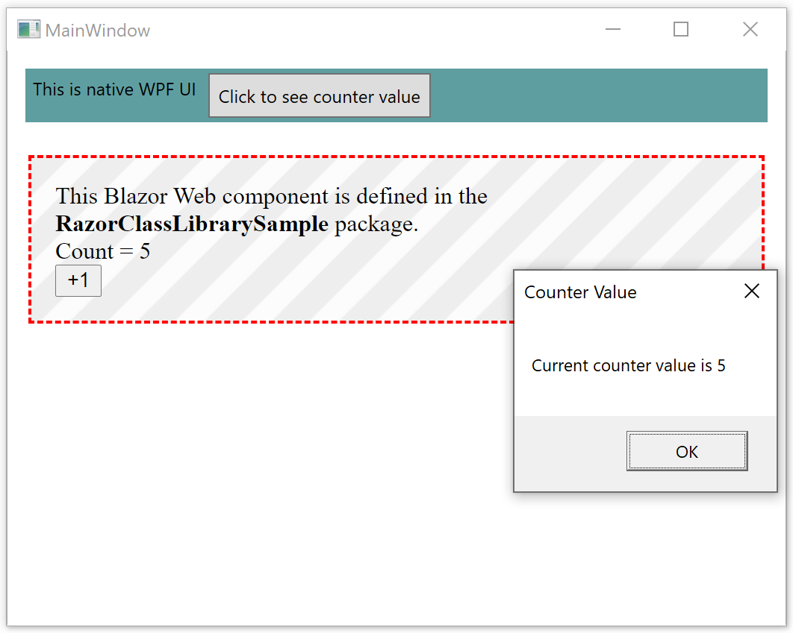
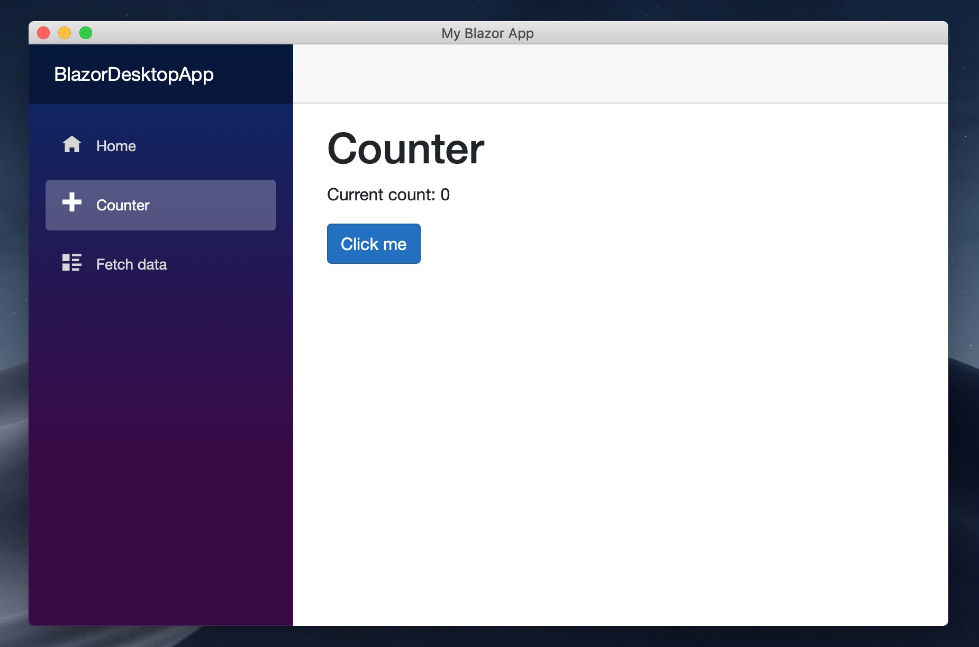
Blazor desktop
Running natively on Windows and macOS via MAUI
BlazorWebView for WPF and Windows Forms

Slide 36

MAUI

Slide 37
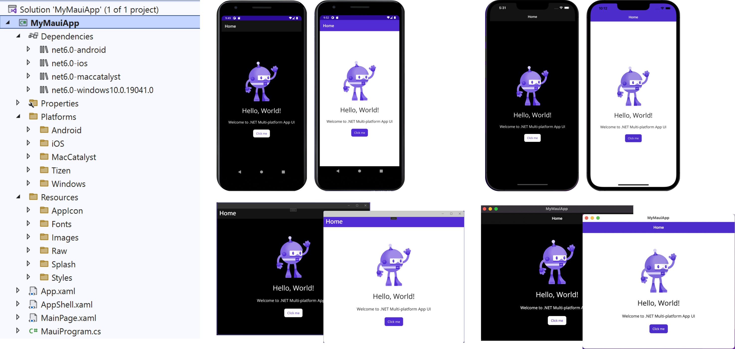
Xamarin.Forms => MAUI
Support for iOS, Android, macOS, Windows, Tizen
Single project, using platform folders
Sharing code and resources across platforms
Images, icons, fonts, manifests
Host model using IAppHostBuilder
Dependency injection and lifecycle events
Shared MauiApp class and per-platform applications
Hot Reload support
Windows App SDK (Project Reunion)
Essentials (previously Xamarin.Essentials) for common device features is included in core
.NET MAUI Community Toolkit
Third-party components – DevExpress, Syncfusion, Telerik...
Performance improvement over Xamarin.Forms
Control customization is easier than with Xamarin.Forms
Multi-window apps and popups
Menus for desktop apps
maui-check tool – check and fix the requirements
Supported in Microsoft.Identity.Client for authentication
Notes:
https://devblogs.microsoft.com/dotnet/announcing-net-multi-platform-app-ui-preview-3/
https://devblogs.microsoft.com/dotnet/announcing-net-maui-preview-5/
https://devblogs.microsoft.com/dotnet/announcing-net-maui-preview-6/
https://devblogs.microsoft.com/dotnet/introducing-the-net-maui-community-toolkit-preview/
https://devblogs.microsoft.com/dotnet/update-on-dotnet-maui/
https://devblogs.microsoft.com/dotnet/announcing-net-maui-preview-9/
https://devblogs.microsoft.com/dotnet/announcing-net-maui-preview-10/
https://devblogs.microsoft.com/dotnet/announcing-net-maui-preview-12/
https://devblogs.microsoft.com/dotnet/announcing-net-maui-preview-13/
https://devblogs.microsoft.com/dotnet/dotnet-maui-preview-14/
https://devblogs.microsoft.com/dotnet/dotnet-maui-rc-2/
https://devblogs.microsoft.com/dotnet/dotnet-maui-rc-3/
https://devblogs.microsoft.com/dotnet/performance-improvements-in-dotnet-maui/
https://devblogs.microsoft.com/dotnet/customizing-dotnet-maui-controls/
https://devblogs.microsoft.com/dotnet/dotnet-maui-visualstudio-2022-release/
https://devblogs.microsoft.com/dotnet/dotnet-maui-ebook-released/
https://devblogs.microsoft.com/dotnet/dotnet-maui-in-dotnet-7-rc1/
https://devblogs.microsoft.com/dotnet/authentication-in-dotnet-maui-apps-msal/

Slide 38
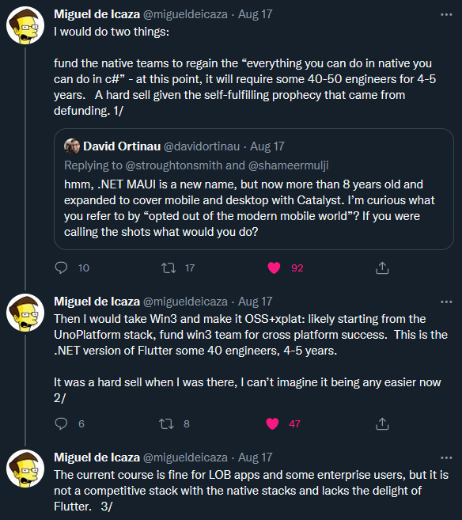

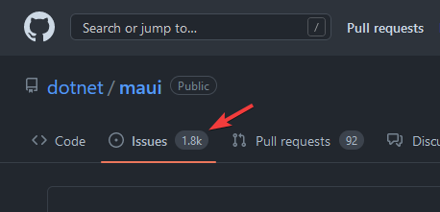
Is it ready?
No out-of-the-box support for Linux
Unstable
Notes:
https://visualstudiomagazine.com/articles/2022/09/29/net-maui-complaints.aspx
https://twitter.com/migueldeicaza/status/1559898665350832128

Slide 39
.NET MAUI Blazor / Blazor Hybrid
BlazorWebView control
Desktop, mobile, and web
Notes:
https://devblogs.microsoft.com/dotnet/asp-net-core-updates-in-net-6-preview-4/#net-maui-blazor-apps
https://www.codemag.com/Article/2111092/Blazor-Hybrid-Web-Apps-with-.NET-MAUI

Slide 40



Alternatives
Uno platform - https://platform.uno/
Avalonia UI - https://avaloniaui.net/
Flutter - https://flutter.dev/
Notes:
https://platform.uno/blog/top-50-reasons-to-use-uno-platform-2022-edition/

Slide 41

Other

Slide 42

gRPC in .NET 6
Increased Protobuf performance
Download speed improvements
HTTP/3 support
Client-side load balancing
Distributes load optimally across available servers
No need for proxy server
Transient fault handling with retries in clients
Notes:
https://devblogs.microsoft.com/dotnet/grpc-in-dotnet-6/

Slide 43
gRPC in .NET 7
JSON transcoding
Use gRPC services like RESTful HTTP APIs
OpenAPI support [Experimental]
Notes:
https://devblogs.microsoft.com/dotnet/announcing-grpc-json-transcoding-for-dotnet/
https://devblogs.microsoft.com/dotnet/asp-net-core-updates-in-dotnet-7-rc-1/#experimental-openapi-support-for-grpc-json-transcoding

Slide 44

CoreWCF
1.0 released in April 2022.
Community project
Features are a subset of functionality from WCF
HTTP and NetTCP transports
BasicHttpBinding, NetHttpBinding, NetTcpBinding, WebHttpBinding, WSHttpBinding (some WS-* features are not supported)
Transport security, Username, Certificate and Windows auth, WS Federation...
WSDL generation
Partial configuration support including service and endpoints
Extensibility (IServiceBehavior and IEndpointBehavior)
Not implemented
Transports other than HTTP and NetTCP
Message security beyond Transport and Transport with Message Credentials
Distributed transactions
Message Queueing
Project templates added in 1.1
Notes:
https://devblogs.microsoft.com/dotnet/corewcf-v1-released/
https://devblogs.microsoft.com/dotnet/corewcf-1-1-0-and-project-templates/

Slide 45

Monitoring and metrics in .NET 6
OpenTelemetry 1.x
Observability - distributed tracing, metrics...
A bridge between System.Diagnostics and the greater OpenTelemetry ecosystem, OTLP protocol, OpenTelemetry Collector
Exporters to Jaeger, Zipkin, OTLP
dotnet monitor tool
Collects and dumps process diagnostic information
Either from desktop or Kubernetes cluster
Can be used as a sidecar container
Exposes HTTP API
IHttpActivityFeature in ASP.NET Core
Notes:
https://devblogs.microsoft.com/dotnet/opentelemetry-net-reaches-v1-0/
https://devblogs.microsoft.com/dotnet/monitoring-and-observability-in-cloud-native-asp-net-core-apps/
https://devblogs.microsoft.com/dotnet/whats-new-in-dotnet-monitor/
https://devblogs.microsoft.com/dotnet/asp-net-core-updates-in-net-6-preview-6/#ihttpactivityfeature
https://devblogs.microsoft.com/dotnet/announcing-dotnet-monitor-in-net-6/

Slide 46
Monitoring and metrics in .NET 7
Added metrics for Microsoft.Extensions.Caching
MemoryCacheStatistics – cache hit/miss/estimated size and count
IMemoryCache.GetCurrentStatistics()
Notes:
https://devblogs.microsoft.com/dotnet/announcing-dotnet-7-preview-4/#added-metrics-for-microsoft-extensions-caching

Slide 47
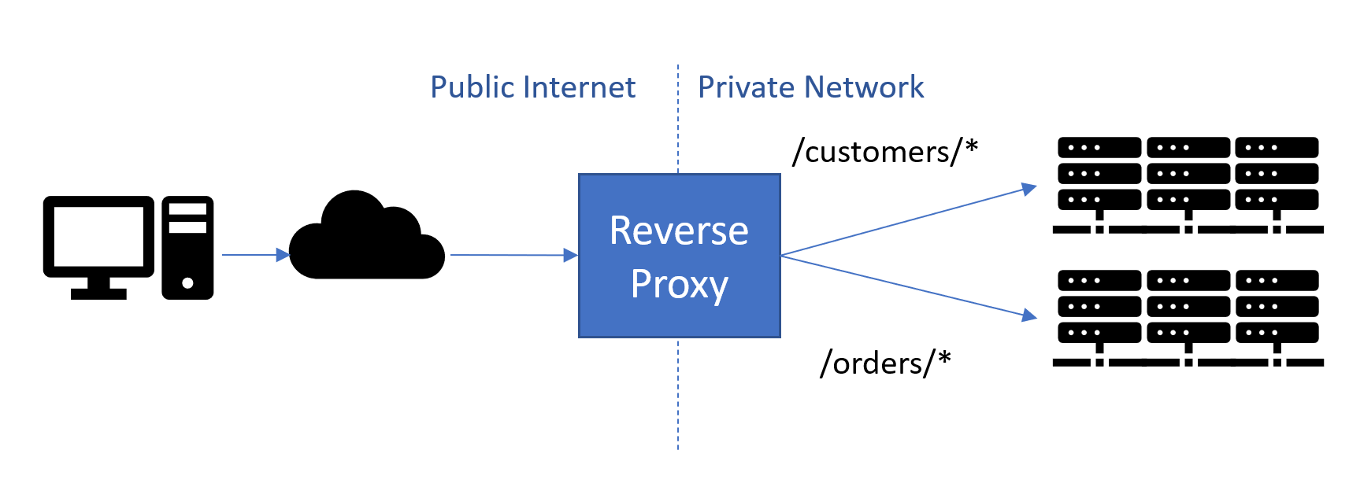
YARP 1.0
YARP = Yet another reverse proxy
Configuration via static config files, or programmatic
Front multiple sites and route based on SNI/Host
Routing based on request URL and header values
Health checks
Session affinity – same destination
Load balancing
Authentication and authorization
Proxying URLs and header transformation
gRPC and web sockets support, including streaming
Metrics and logging
Cloud-scale performance
Easily extensible
Open-source
Notes:
https://devblogs.microsoft.com/dotnet/announcing-yarp-1-0-release/

Slide 48
YARP 1.1
May 2022.
Zero byte reads
Performance optimization
Detects if data is waiting on the stream, and only then allocate memory buffer for the reads
Multi-value header matching
HTTP/3 support
Multiple configuration sources
Http.Sys delegation – if YARP is hosted by Http.Sys
APIs for Middleware
Notes:
https://devblogs.microsoft.com/dotnet/yarp-reverse-proxy-1-1-release/

Slide 49
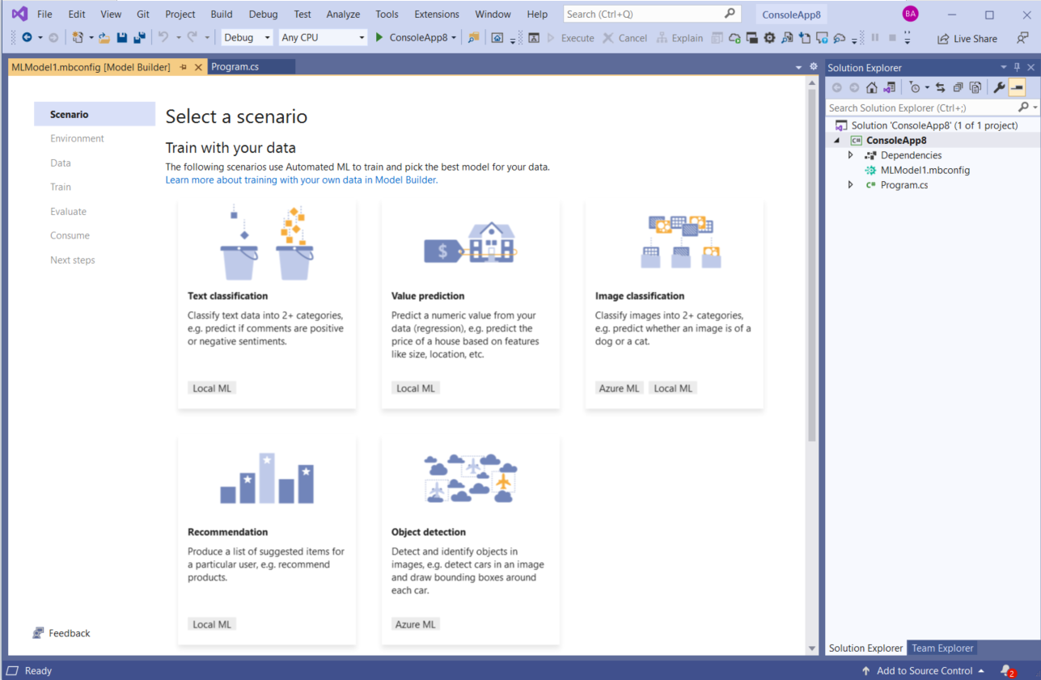
ML.NET
Microsoft.Extensions.ML NuGet package
PredictionEnginePool – deploying ML models as web services
Model Builder improvements
AutoML performance improvements and new features
Notebook Editor in VS
The Experiment API
Text Classification API using TorchSharp
Notes:
Model Builder redesigned, config based with code behind files (.mbconfig)...
https://devblogs.microsoft.com/dotnet/ml-net-and-model-builder-october-updates/

Slide 50
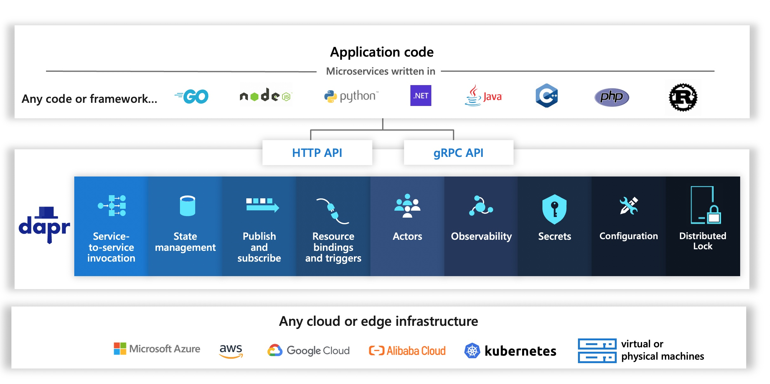
Distributed applications
Microsoft Orleans
Distributed applications framework – distributed .NET
Aligned with .NET 7
Orleans 4.0 => Orleans 7.0
Dapr
Distributed application runtime
Notes:
https://github.com/dotnet/orleans

Slide 51
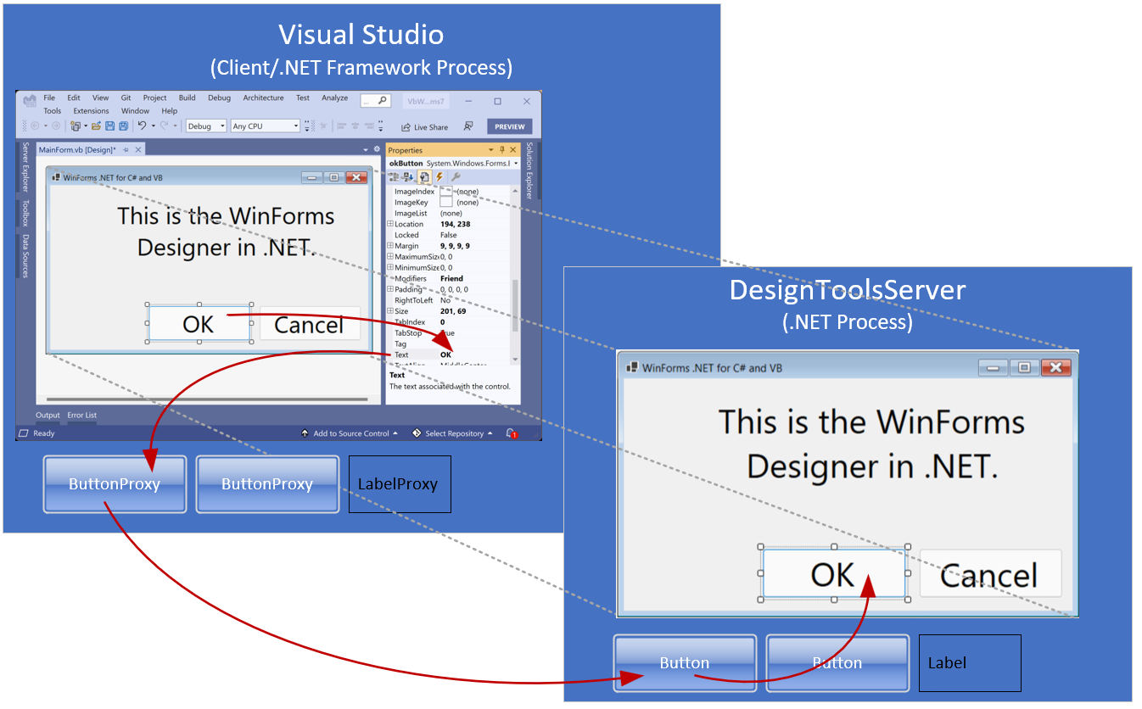
Desktop
Windows Forms
Out of process designer with DesignToolsServer
Template updates
Application-wide default font
More runtime designers
Accessibility improvements
High DPI and scaling fixes
WPF
Template updates
Notes:
https://devblogs.microsoft.com/dotnet/whats-new-in-windows-forms-in-net-6-0-preview-5/
https://devblogs.microsoft.com/dotnet/whats-new-in-windows-forms-in-net-6-0/
https://devblogs.microsoft.com/dotnet/state-of-the-windows-forms-designer-for-net-applications/

Slide 52
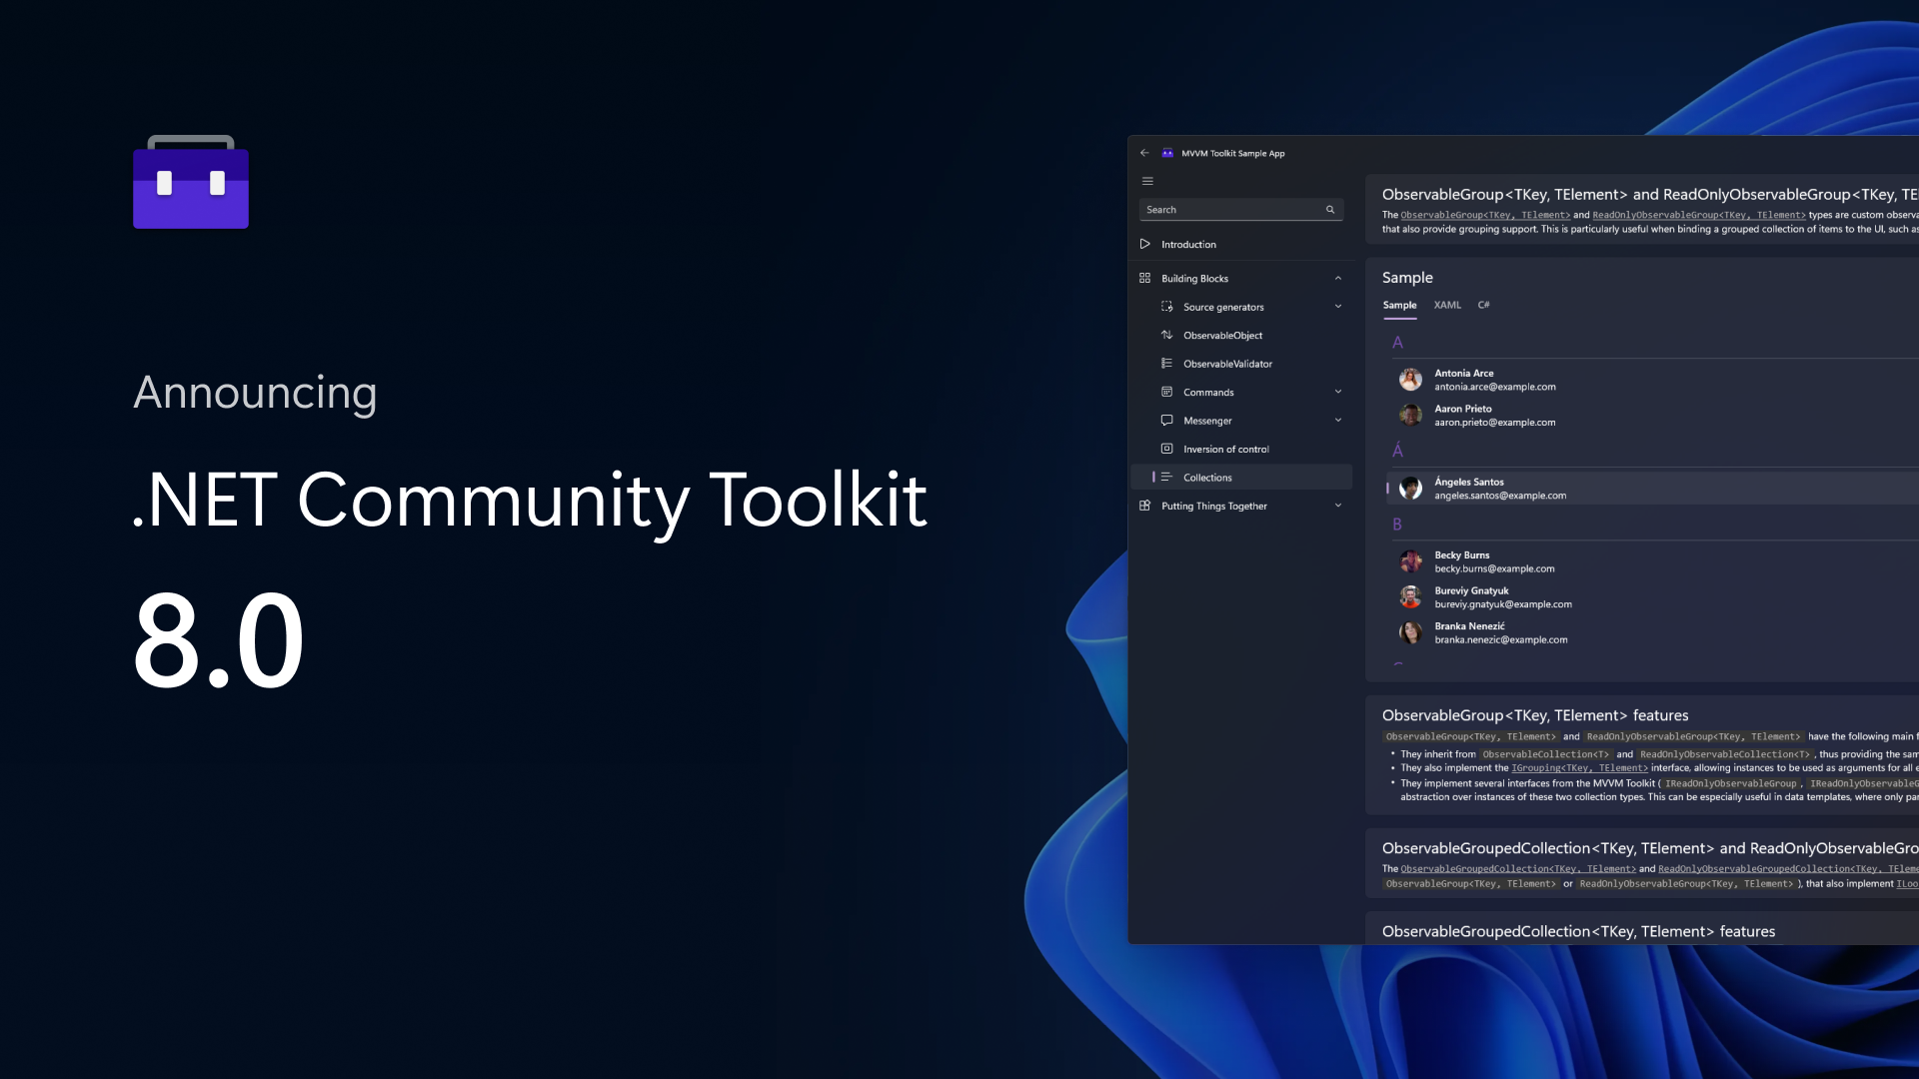
.NET Community Toolkit
Helpers and APIs for any UI platform
MVVM Toolkit
Inspired by MvvmLight
Source generators
Commands
Observable properties
Improved messenger APIs
Sample app
Improved diagnostics API
Guard...
Notes:
https://devblogs.microsoft.com/dotnet/announcing-the-dotnet-community-toolkit-800/

Slide 53
Cloud and dogfooding
AppService is using Kestrel + YARP
Azure Functions supports .NET 7
Amazon EC2 and AWS Lambda support .NET 7
Azure Active Directory Gateway on .NET 6
Microsoft Graph on .NET 6
Azure Cosmos DB on .NET 6
Exchange Online on .NET 6
Dynamics 365 is using YARP
Microsoft Commerce on .NET 6
Microsoft Teams Infrastructure and Assignments on .NET 6
Bing Ads on .NET 6
Notes:
https://devblogs.microsoft.com/dotnet/azure-active-directorys-gateway-is-on-net-6-0/
https://devblogs.microsoft.com/dotnet/microsoft-graph-dotnet-6-journey/
https://devblogs.microsoft.com/dotnet/the-azure-cosmos-db-journey-to-net-6/
https://devblogs.microsoft.com/dotnet/bringing-kestrel-and-yarp-to-azure-app-services/
https://devblogs.microsoft.com/dotnet/dotnet-7-comes-to-azure-functions/
https://devblogs.microsoft.com/dotnet/microsoft-commerce-dotnet-6-migration-journey/
https://devblogs.microsoft.com/dotnet/microsoft-teams-infrastructure-and-azure-communication-services-journey-to-dotnet-6/
https://devblogs.microsoft.com/dotnet/microsoft-teams-assignments-service-dotnet-6-journey/
https://devblogs.microsoft.com/dotnet/bing-ads-campaign-platform-journey-to-dotnet-6/
https://github.com/aws-samples/aws-net-guides/tree/master/RuntimeSupport/dotnet7

Slide 54

Visual Studio
Visual Studio is a 64-bit application, also Arm64
Git improvements, line staging, multi-repo support
Hot Reload
New project properties designer
Find in files is a lot faster
Theming support and VS Code themes, improved icons and UI
Dev Tunnels for web applications [preview]
Connected Services
Generate HTTP API or gRPC clients – using OpenAPI and proto
Uses dotnet-openapi tool (underlined NSwag code generator)
F# tools updates – mixing C# and F# projects, quick fixes and refactoring, performance...
C# tools updates – IntelliCode, quick fixes and refactoring, new Razor editor...
Extension for ASP.NET to ASP.NET Core migration
VisualStudio.Extensibility
Notes:
https://devblogs.microsoft.com/visualstudio/visual-studio-2022/
https://devblogs.microsoft.com/visualstudio/personalize-your-visual-studio-2022/
https://devblogs.microsoft.com/visualstudio/visual-studio-2022-preview-3-now-available/
https://devblogs.microsoft.com/visualstudio/revamped-project-properties-ui/
https://devblogs.microsoft.com/visualstudio/multi-repo-support-in-visual-studio/
https://devblogs.microsoft.com/visualstudio/visual-studio-2022-preview-4-is-now-available/
Right click, add Connected Service
IntelliSense is for some frequently used features (connection strings, Kestrel, certificates, logging, host filtering...)
https://devblogs.microsoft.com/dotnet/f-and-f-tools-update-for-visual-studio-16-10/
https://devblogs.microsoft.com/visualstudio/introducing-private-preview-port-tunneling-visual-studio-for-asp-net-core-projects/
https://devblogs.microsoft.com/visualstudio/visualstudio-extensibility/

Slide 55

Visual Studio Code
https://vscode.dev/
Visual Studio Code Server
.NET Interactive - .NET Notebooks
C#, F#, PowerShell, JavaScript, HTML, T-SQL
Workspace Trust
Tye extension
Tye Explorer
Scaffolding
Debugging
Notes:
https://devblogs.microsoft.com/dotnet/announcing-visual-studio-code-extension-for-tye/

Slide 56



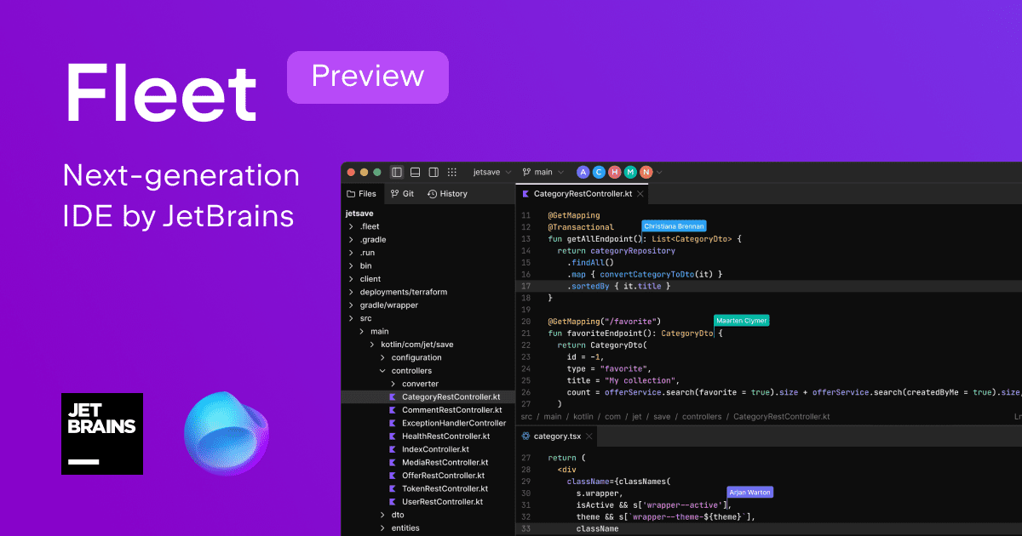
JetBrains
ReSharper
Rider
Fleet

Slide 57
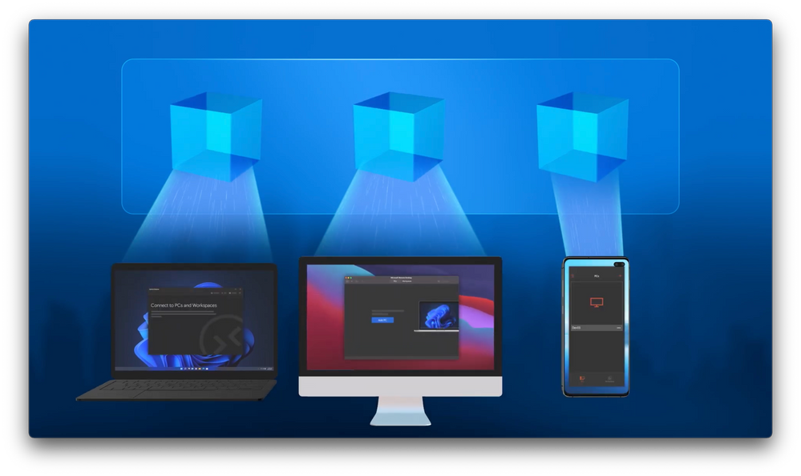


Dev tools
Microsoft Dev Box – workstations in the cloud
GitHub Codespaces – dedicated dev environment
GitHub Copilot
Notes:
https://azure.microsoft.com/en-us/blog/announcing-microsoft-dev-box-preview/
https://docs.github.com/en/codespaces
https://docs.github.com/en/copilot

Slide 58

Closing up...

Slide 59
Which .NET version to use?
.NET Framework 4.x
No!
Migrate
Reconsider architecture
.NET LTS
.NET 6, .NET 8...
For published projects that are in maintenance mode
.NET Current
.NET 7, .NET 9...
For projects in active development

Slide 60

The future
https://www.dotnetconf.net/
https://themesof.net/

Slide 61
References
.NET Blog
https://devblogs.microsoft.com/dotnet/
.NET on YouTube – community standups, etc.
https://www.youtube.com/dotnet
Themes of .NET
https://themesof.net/
C# proposals
https://github.com/dotnet/csharplang/tree/main/proposals
Andrew Lock – exploring .NET 6
https://andrewlock.net/series/exploring-dotnet-6/

Slide 63
Thank you!
https://github.com/miroslavpopovic/dotnet-6-and-7
https://github.com/miroslavpopovic/minimal-apis-sample
Questions?
Miroslav Popović Technical Lead @Seavus @miroslavpopovic

